Slide 1
OOP
Lecture # 21
Stack

Slide 2
Introduction
A stack is a useful data structure in programming.
A stack is a container of objects that are inserted and removed according to the last-in first-out (LIFO)/ FILO principle.
Also referred as abstract data type(ADT) in many programming languages.
Also called limited access data structure.
Notes:
A stack is a limited access data structure - elements can be added and removed from the stack only at the top.

Slide 3

Example
It is just like a pile of plates kept on top of each other or a deck of cards.
Notes:
A real-world stack allows operations at one end only. For example, we can place or remove a card or plate from the top of the stack only. Likewise, Stack ADT allows all data operations at one end only. At any given time, we can only access the top element of a stack.

Slide 4
Terminology
LIFO/FILO
Push
Pop

Slide 5
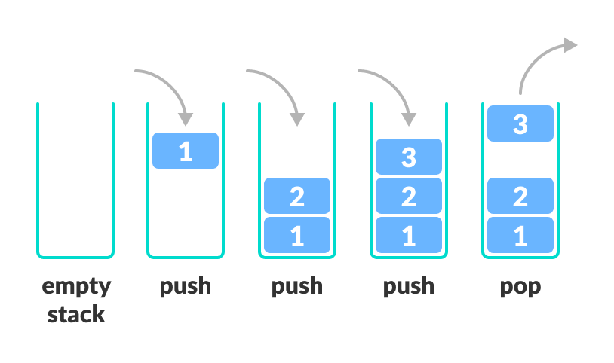

Slide 6
Implementation
Can be implemented using:
Arrays,
Structures,
Pointers,
Linked Lists
It can have fixed size or can be resized dynamically.

Slide 7
Applications
The simplest application of a stack is to reverse a word. You push a given word to stack - letter by letter - and then pop letters from the stack.
Another application is an "undo" mechanism in text editors; this operation is accomplished by keeping all text changes in a stack.
Backtracking: This is a process when you need to access the most recent data element in a series of elements.
Notes:
Think of a labyrinth or maze - how do you find a way from an entrance to an exit?
Once you reach a dead end, you must backtrack. But backtrack to where? to the previous choice point. Therefore, at each choice point you store on a stack all possible choices. Then backtracking simply means popping a next choice from the stack.

Slide 8
Language processing:
space for parameters and local variables is created internally using a stack.
compiler's syntax check for matching braces is implemented by using stack.
support for recursion
In compilers :
Compilers use the stack to calculate the value of expressions like 2 + 4 / 5 * (7 - 9) by converting the expression to prefix or postfix form.
In browsers :
The back button in a browser saves all the URLs you have visited previously in a stack. Each time you visit a new page, it is added on top of the stack. When you press the back button, the current URL is removed from the stack and the previous URL is accessed.

Slide 9
Operations
A stack is an object or more specifically an abstract data structure(ADT) that allows the following operations:
Push: Add an element to the top of a stack
Pop: Remove an element from the top of a stack
IsEmpty: Check if the stack is empty
IsFull: Check if the stack is full
Peek: Get the value of the top element without removing it

Slide 10
Working
The operations work as follows:
A pointer called TOP is used to keep track of the top element in the stack.
When initializing the stack, we set its value to -1 so that we can check if the stack is empty by comparing TOP == -1.
On pushing an element, we increase the value of TOP and place the new element in the position pointed to by TOP.
On popping an element, we return the element pointed to by TOP and reduce its value.
Before pushing, we check if the stack is already full
Before popping, we check if the stack is already empty

Slide 11
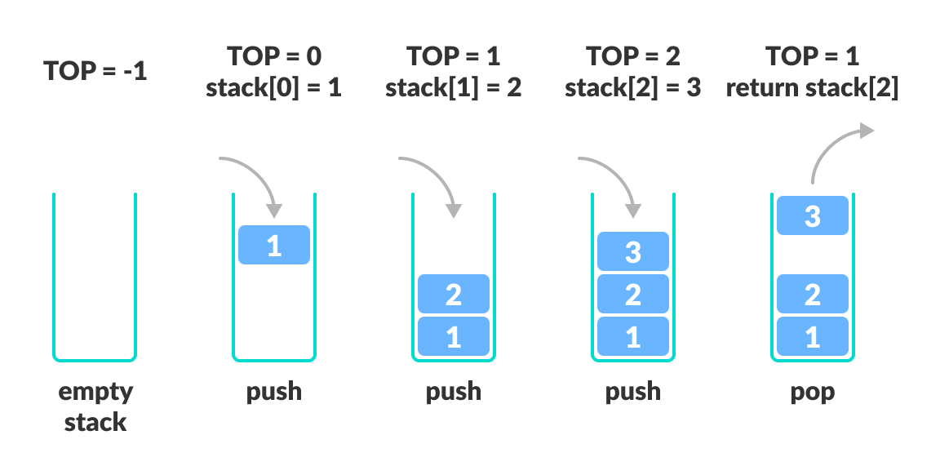

Slide 12
Home Task
Implement Stack using Linked lists

Slide 13
References
https://www.programiz.com/dsa/stack
https://www.tutorialspoint.com/data_structures_algorithms/stack_algorithm.htm
https://www.cs.cmu.edu/~adamchik/15-121/lectures/Stacks%20and%20Queues/Stacks%20and%20Queues.html

